Slide 1
Web Traffic Prediction with
Machine Learning
using
Python
Vikas CE-4129-2K16
Rohit Kumar CE-4115-2K16

Slide 2
Project Objective :
The main aim of the project is to extrapolate the future visitors of YMCAUST website using the past visitors data with the help of Regression algorithms(Linear and Polynomial) of Machine Learning.

Slide 3
INTRODUCTION

Slide 4
Machine Learning :
Machine learning is an application of Artificial Intelligence(AI) that provides systems the ability to automatically learn and improve from experience without being explicitly programmed.
The goal of machine learning is to allow the computers to learn automatically without any human intervention or assistance and take actions accordingly.
It begins with observations or data to look for patterns in the data and make better decisions in the future.

Slide 5
Structure :
Python Libraries/Tools:
Anaconda Environment with Python support
Numpy
Scikit-learn
Matplotlib
Pandas
Flask
HTML/CSS

Slide 6
Python Libraries :
Numpy - is a library for the Python programming language, adding support for large, multi-dimensional arrays and matrices, along with a large collection of high-level mathematical functions to operate on these arrays.
Pandas - is a free software machine learning library for the Python programming language. It features various classification, regression and clustering algorithms including support vector machines, random forests, gradient boosting, k-means and DBSCAN etc.

Slide 7
Python Libraries :
Matplotlib - is a plotting library for the Python programming language and its numerical mathematics extension NumPy. It provides an object-oriented API for embedding plots into applications using general- purpose GUI toolkits.
Scikit-learn - is a software library written for the Python programming language for data manipulation and analysis. In particular, it offers data structures and operations for manipulating numerical tables and time series.

Slide 8
Python Libraries :
Flask - Flask is a micro web framework written in Python. It is classified as a microframework because it does not require particular tools or libraries. It has no database abstraction layer, form validation, or any other components where pre-existing third-party libraries provide common functions.

Slide 9
APPROACH
AND
WORKING

Slide 10
STEP 1: Collection of Data
Firstly we convert the gathered data into number of visits per day for the one year which is given in number of visits per hour present in the file ‘visitors_per_hour.txt’ and save them into a file named as ‘visitors_per_day.txt’

Slide 11
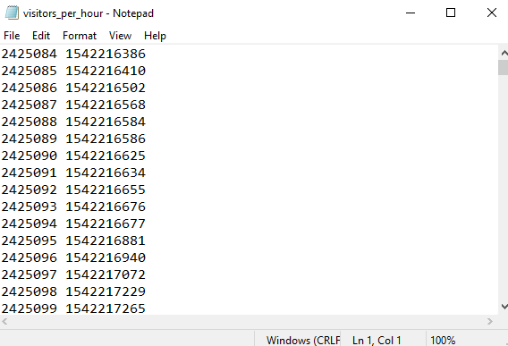
Initial Data :

Slide 12
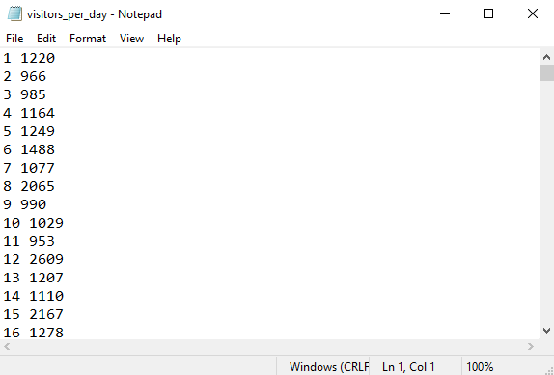
Final Data :

Slide 13
STEP 2: Pre-processing and Cleaning of Data
We will transform the data into two vectors. The first vector day, will contain the days and the second vector hits will contain the web hits on that particular day. Using this data we will plot graphs using the Matplotlib library.

Slide 14
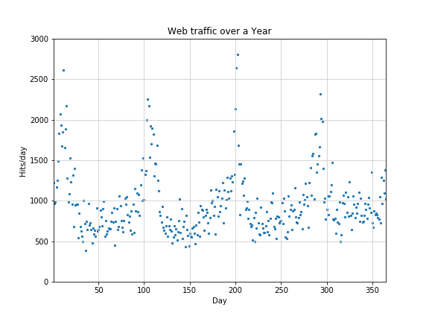
Initial Plotting :

Slide 15
What are Outliers?
Outlier is an observation that appears far away and diverges from overall pattern in sample and can cause serious problems in statistical analysis.
Eg:- Consider the Five data points 3,4,2,4,7,5,10,12,1000,9,8,12,13
Here 1000 is the outlier
It will have an major effect on the mean which is usually used for analysis.

Slide 16
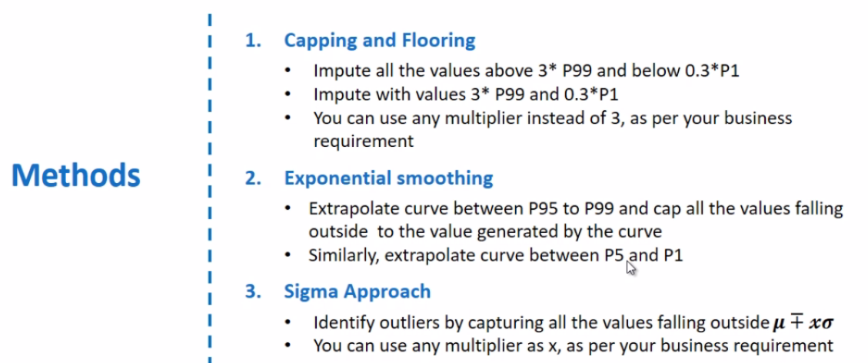
Outliers Treatment :

Slide 17
Sigma Approach for Outlier Treatment :
With the sigma approach, a value is identified as outlier if it lies outside the mean by + or – “x” times sigma. Where x is an integer and sigma is standard deviation for the variable.
UL = Mean + x * Standard_Deviation
LL = Mean – x * Standard_Deviation
The outlier is then capped or floored at a distance of ”y” times sigma from the mean. “y” is equal to or greater than “x” and is determined by the practitioner.
If data point is greater than UL then
hits[i] = hits[i] – y * Standard_Deviation
If data point is less than LL then
hits[i] = hits[i] + y * Standard_Deviation

Slide 18

Analyzing the Data :
Using the scipy.describe() function we can analyze our data as shown above:-
Minimum value = 382
Maximum value = 2801
Mean = 963.331
Variance = 153580.782
Standard Deviation = 391.893 (Square root of Variance)

Slide 19
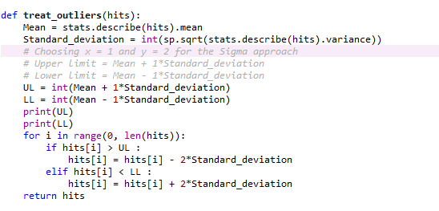
Implementation of Outlier Treatment :

Slide 20
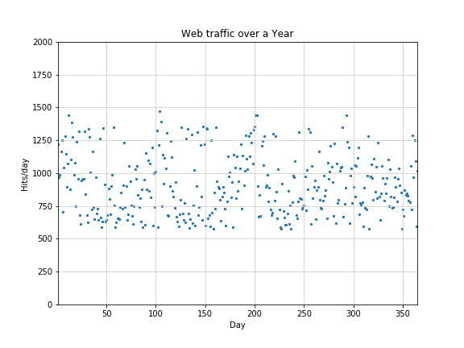
Plotting data after Outliers Treatment :

Slide 21
STEP 3: Applying ML on the Data
Using Scikit-learn library we will apply Regression algorithm on the data, we will use gradient descent to calculate weights for the parameters of linear regression which then be used to predict web traffic in future. We will further use the advanced polynomial regression algorithm.

Slide 22
Linear Regression :
In linear regression, the model targets to get the best-fit regression line to predict the value of y based on the given input value (x). While training the model, the model calculates the cost function which measures the Root Mean Squared error between the predicted value and true value (y). The model targets to minimize the cost function.
y = mx + c (basic equation of line)
We start with c and m with 0 then find the best possible values using gradient descent.

Slide 23
Working of Gradient Descent :

Slide 24
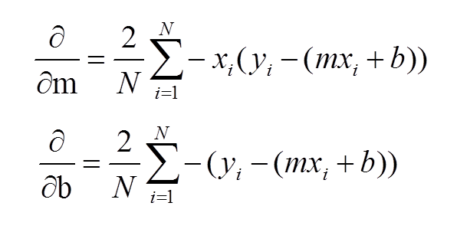
Gradient Descent Formulae :

Slide 25
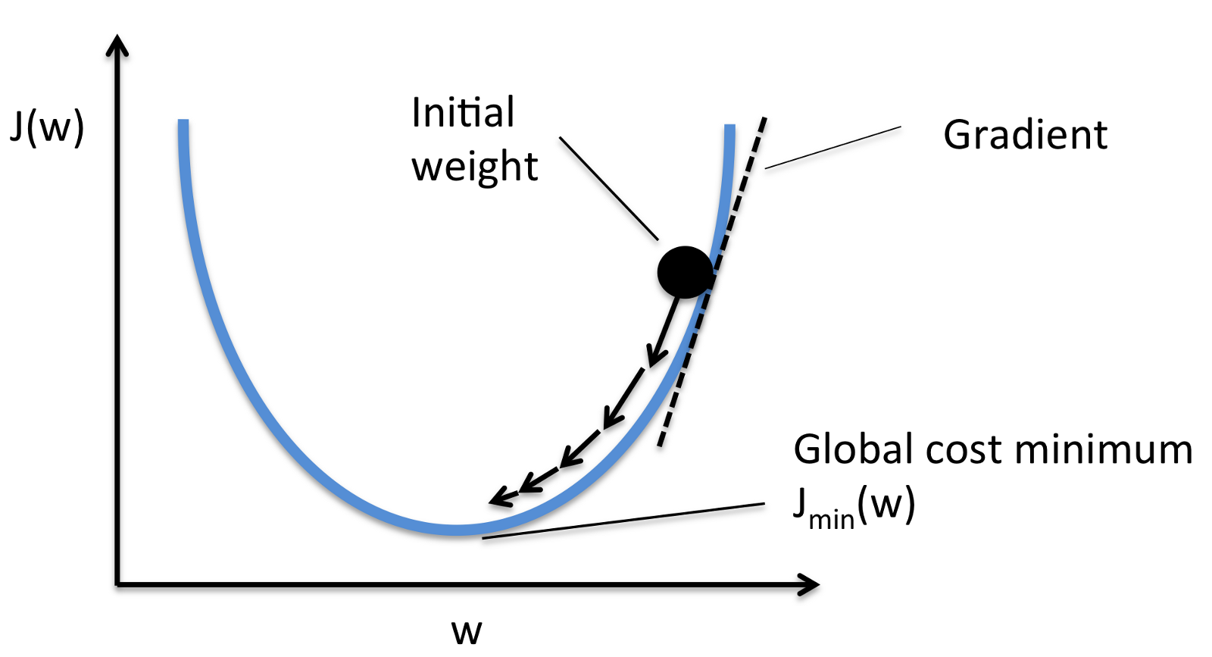
Gradient Descent V/S Loss :

Slide 26
Loss Function :
Using the L2 loss or Squared Error :
def error(f, x, y):
return sp.sum((f(x) - y) ** 2)

Slide 27
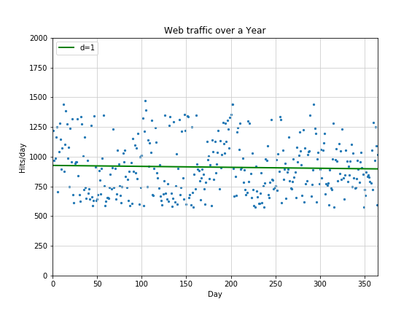

Applying Linear Regression on data :

Slide 28
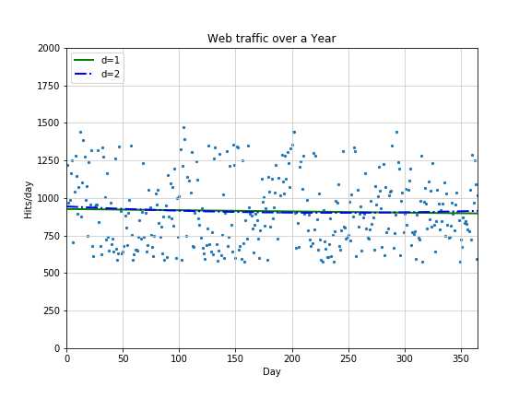

Fitting 2 Degree Model :

Slide 29
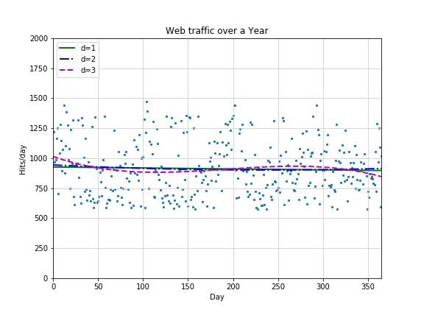

Fitting 3 Degree Model :

Slide 30
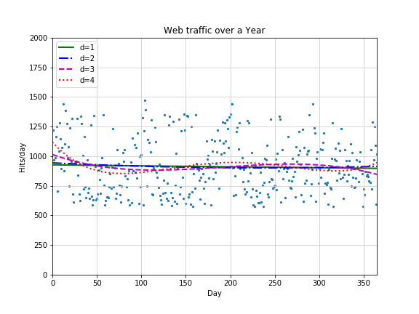

Fitting 4 Degree Model :

Slide 31
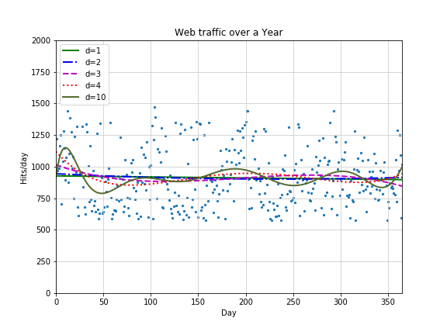

Fitting the 10 Degree Model :

Slide 32
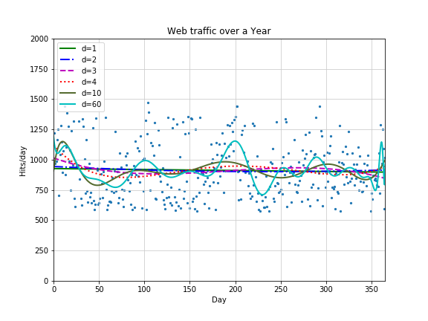

Trying to fit 100 Degree Model :

Slide 33
Why 60 Degree instead of 100 Degree Model :
We see d=60 for the polynomial that had been fitted with 100 degrees and also we see lots of warnings on the console:
RankWarning: Polyfit may be poorly conditioned
This means because of numerical errors, polyfit cannot determine a good fit with 100 degrees. Instead, it figured that 60 must be good enough.

Slide 34
Underfitting :
The lower degree models (that is for degree 1, 2 and 3) does not seem to be capable of capturing the data good enough and thus have large error. So these models can’t be used for extrapolating into the future.
This is known as Underfitting

Slide 35
Overfitting :
The higher degree models (that is for degree 10 and 60) are so much modelled according to the data such that they are also capturing the noisy data. So these models can’t be used for extrapolation.
This is known as Overfitting.

Slide 36
Testing our Model :
We will now test our regression model on the test data to confirm that we have chosen the best possible model for our project.
We can find the errors of all the models and confirm that the model with degree 4 is neither overfitting nor underfitting and gives less error.

Slide 37
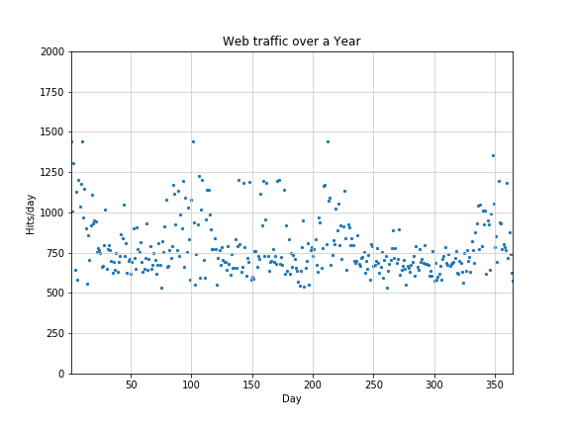
Test data :

Slide 38
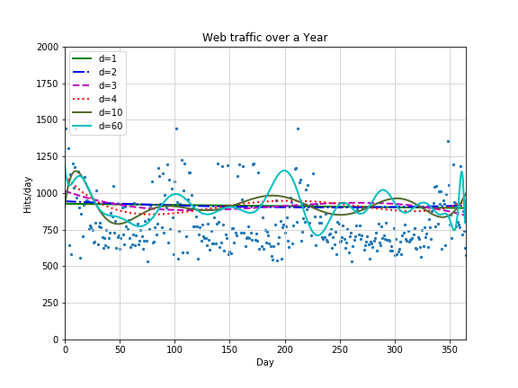
Fitting our models on the test data :

Slide 39
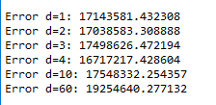
Errors for the test data :
We can clearly see that the degree 4 model gives the least error.

Slide 40
Uses :
Optimized Server Cost :-
The server can be minimized by predicting the web-traffic so that the application do not use a high-power server which cost more but is under utilized.
Preventing Server Overload :-
The website will go down if the server it is using cannot handle the no. of visitors that are currently on the website so we can determine the best server to use which cost less and can handle the users.

Slide 41
References :
[1] Building Machine Learning Systems with Python, Second Edition By Luis Pedro Coelho and Willi Richert.
[2] Selecting the Appropriate Outlier Detection Technique for Common Industry Applications – NESUG 2007
[3] https://github.com/mattnedrich/GradientDescentExample
[4] https://docs.scipy.org/doc/
[5] https://github.com/luispedro/BuildingMachineLearningSystemsWithPython/tree/master/ch01
[6] https://matplotlib.org/contents.html

Slide 42
END!
THANK YOU

